Slide 2
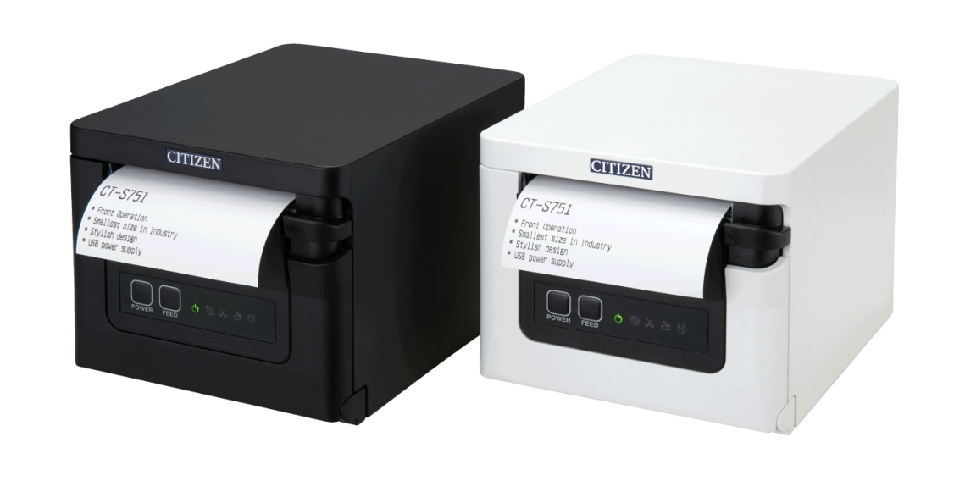
POS 3”
THE ALL-NEW ULTRAFAST
CT-S751
Front loading / exit POS printer with
ergonomic under-counter installation
Flexible connectivity with a stylish, compact & functional design
Notes:
Update the headline

Slide 3
CT-S751 FRONT EXIT / LOADING 3” POS PRINTER
Verticals & Markets
RETAIL
HOSPITALITY
HEALTHCARE
TICKETING
LIBRARIES
LOTTERY / GAMING
Notes:
Refer to pic file

Slide 4
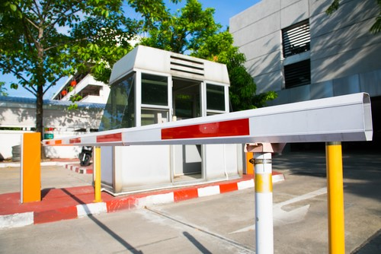
KIOSK
TOLL ROADS
CT-S751
FRONT EXIT / LOADING
3” POS PRINTER
VERTICALS & MARKETS
WEIGHT SCALE
PARKING
Notes:
Refer to pic file

Slide 5
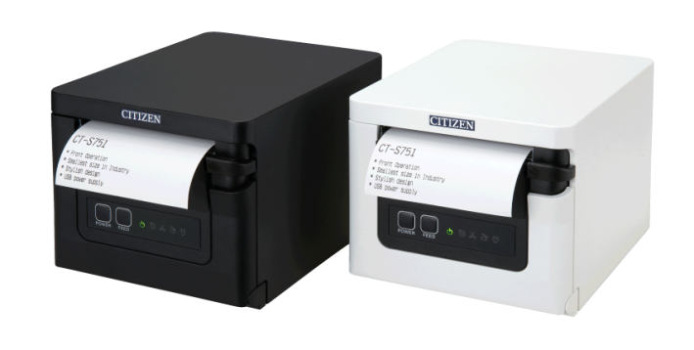
CT-S751
KEY BENEFITS
FRONT LOADING EXIT
STYLISH, COMPACT & FUNCTIONAL
Made for tight spaces without compromising speed or design, under-counter mounting*
FULL HARDWARE & SOFTWARE CONNECTIVITY
Multiple Interfaces and ESC/POS™® Drivers and/or SDKs Windows, iOS, Android, Linux and more
GREAT VALUE, OUTSTANDING PERFORMANCE & SLEEK DESIGN
Ideal for users who value modern aesthetics from retail to healthcare
POS DIRECT THERMAL WITH
SUPERIOR QUALITY & SPEED
Prints in 203 dpi with a 350 mm/s print speed
*Optional
Notes:
- Standard interface is USB
- Optional interfaces are also available: Serial, Ethernet, Bluetooth and WiFi

Slide 6
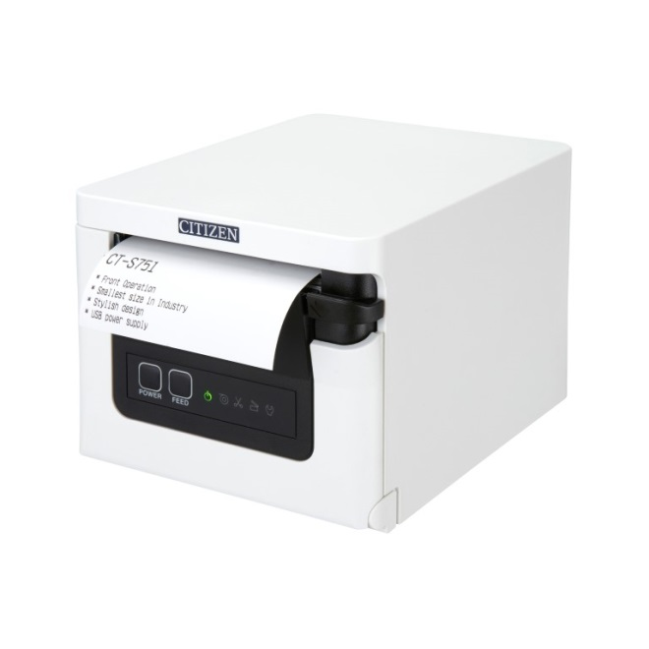
CT-S751 FRONT LOADING / EXIT 3” POS PRINTER
Highlights & Features
User friendly
ergonomic front loading
Quick and easy media loading
3-inch media: up to 80mm
Compact & sleek case with front exit
Made to fit in tight spaces, same height as a cash drawer
Case available in
Black or White Colours to fit various types of environments
mPOS ready with USB charging
SDKs for iOS, Android and Windows Mobile
Functional & stylish design with speed in mind
Fast print speed out 350mm/s. Full and partial cutting with paper saving
Total Connectivity
USB as standard. Opt. Serial, Ethernet, Bluetooth and WiFi
Notes:
Greyscale: yes, 16 shades of grey

Slide 7
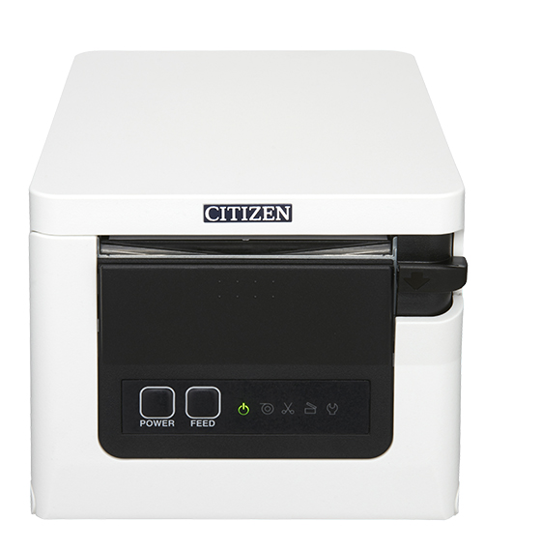
CT-S751
HIGHLIGHTS &
FEATURES
The perfect match for modern POS Sophisticated design to meet aesthetics, fits well under POS systems with a flexible screen
Front exit design
Front loading / exit make it ideal for hospitality, as it's harder to spill drinks/food into the printer
Serve up to 1,000,000 customers
A 200 km printer and head warranty
(Average receipts length 20 cm)
Notes:
Update 1st icon

Slide 8
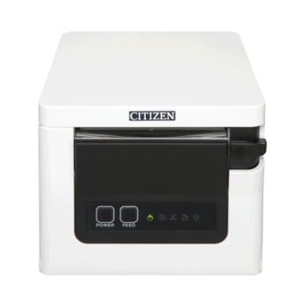
CT-S751
mPOS READY
MOBILE CONNECTIVITY
The CT-S751 is made to fulfill your mPOS printing requirements, featuring:
Multiple interfaces
Mobile but also stationary printers
iOS, Android and Windows Mobile
SDKs and other toolkits
Easy set-up, simple to use solutions

Slide 9
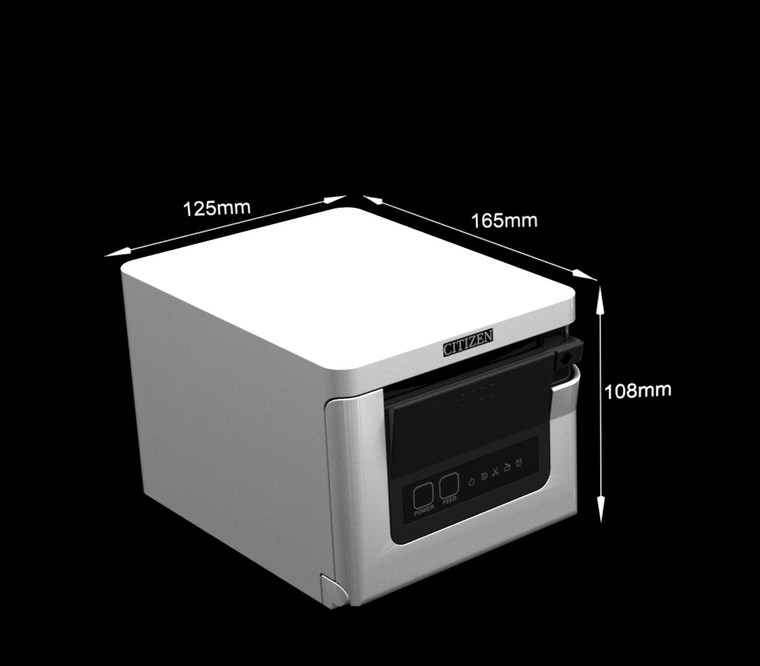
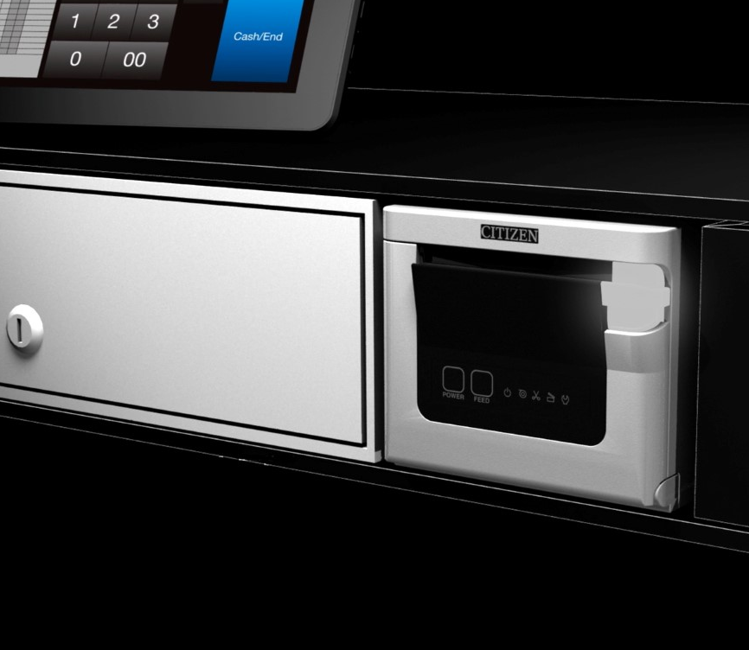
CT-S751
ULTRA
COMPACT
Perfect match between high performance and functional design.
Thanks to its front exit and front loading is the CT-S751 is made to fit into tight spaces without compromising speed, while featuring a modern high-end design.
Notes:
A lot of retail shops especially the ones that are high-end are focusing on design today and want to have clean desks, for this reason they try to minimize the POS system , the only larger POS equipment is in this case would be the printer and the cash drawer which both can be hided offering complying with clean easthetics and work area / countertop.

Slide 10
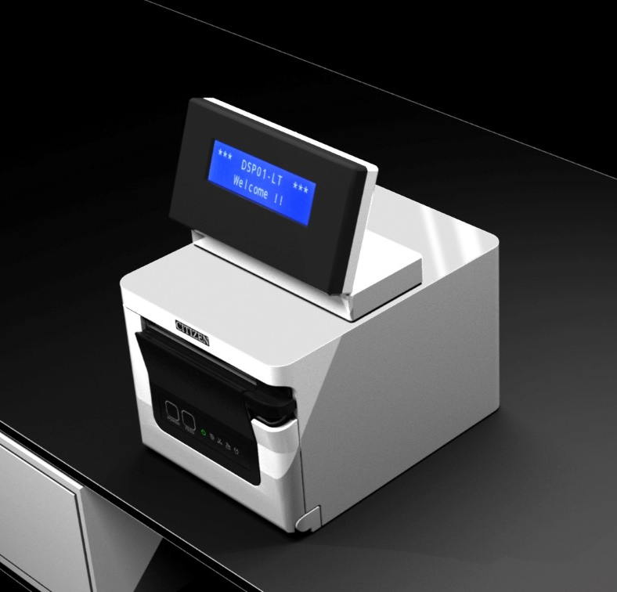
CT-S751
FLAT-TOP
DESIGN
Stylish case made to fit design oriented mPOS systems
Thanks to its compact size the
CT-S751 fit well with flexible screen or minimalistic POS systems
Notes:
A lot of retail shops especially the ones that are high-end are focusing on design today and want to have clean desks, for this reason they try to minimize the POS system
CT-S751 minimalistic mPOS solutions which are operated from a tablet

Slide 11
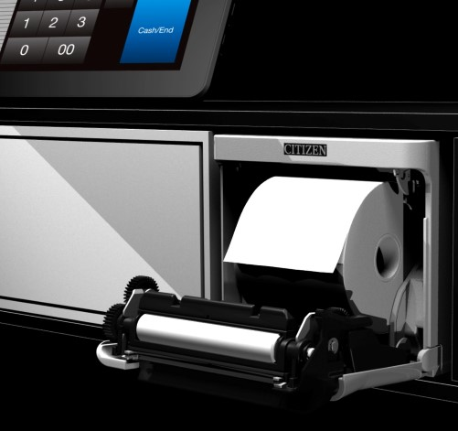
CT-S751
ERGONOMIC
FRONT LOADING
Fitting tight spaces with the same height of a cash drawer
The CT-S751 can be placed under the desk or counter due to its small footprint while still being ergonomic friendly during operation and media change.

Slide 12
CT-S751
USB
CHARGING
USB port can be used to charge tablet devices like an iPad or Android tablet or phone.
Power delivery: 2.1 Amps

Slide 13
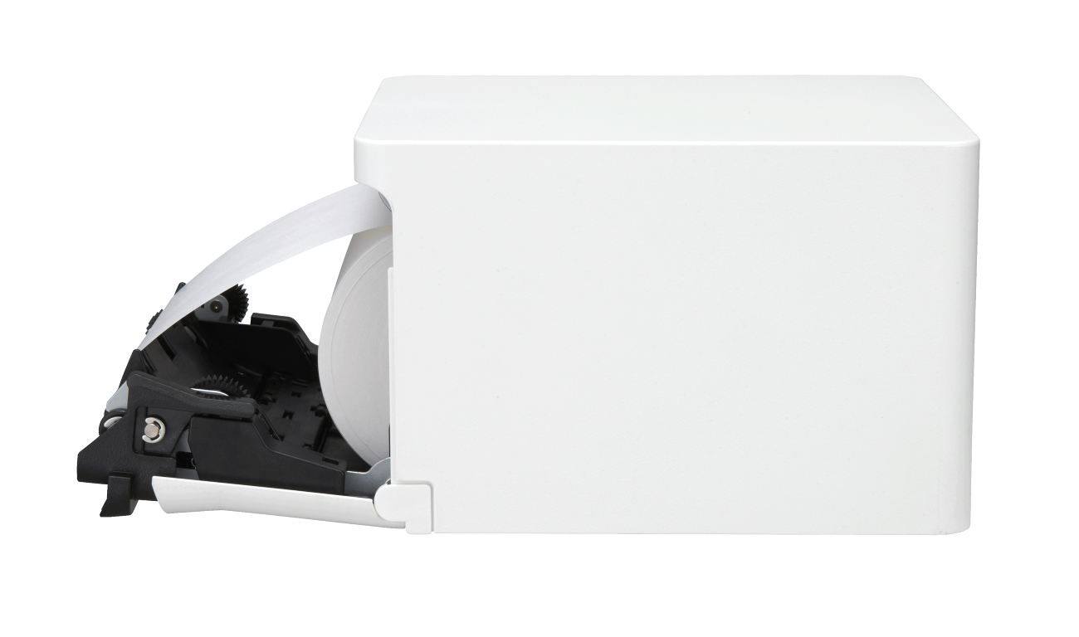
CT-S751
UNDER COUNTER
MOUNTING*
*Optional Accessory
The printer can be securely mounted under the counter with an optional fixture/ bracket.

Slide 14
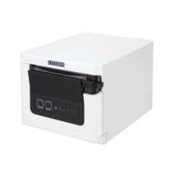
CT-S751
INTERFACES
Total Connectivity: USB as standard.
Optional Serial, Ethernet, Bluetooth and WiFi
USB
USB 2.0, full speed
WiFi
802.11a, b, g, n
Serial RS232C
1,200 to 115,200 baud
Bluetooth
3.0 + EDR, SPP, iAP
Ethernet (LAN)
100Base-TX or 10Base-TX

Slide 15
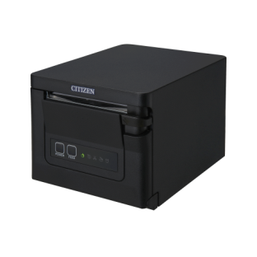
BK
WH
CT-S751
CASE COLOURS
BLACK
Perfect for challenging environments like hospitality or supermarkets
PURE WHITE
Perfect for high end, retail
healthcare, hospitals, clinics & private practices,
Design to be perform and withstand daily use in a variety of environments
Notes:
The front loading and front exit aspect is also ideal within hospitality, as it's harder to spill drinks/food into the printer

Slide 16
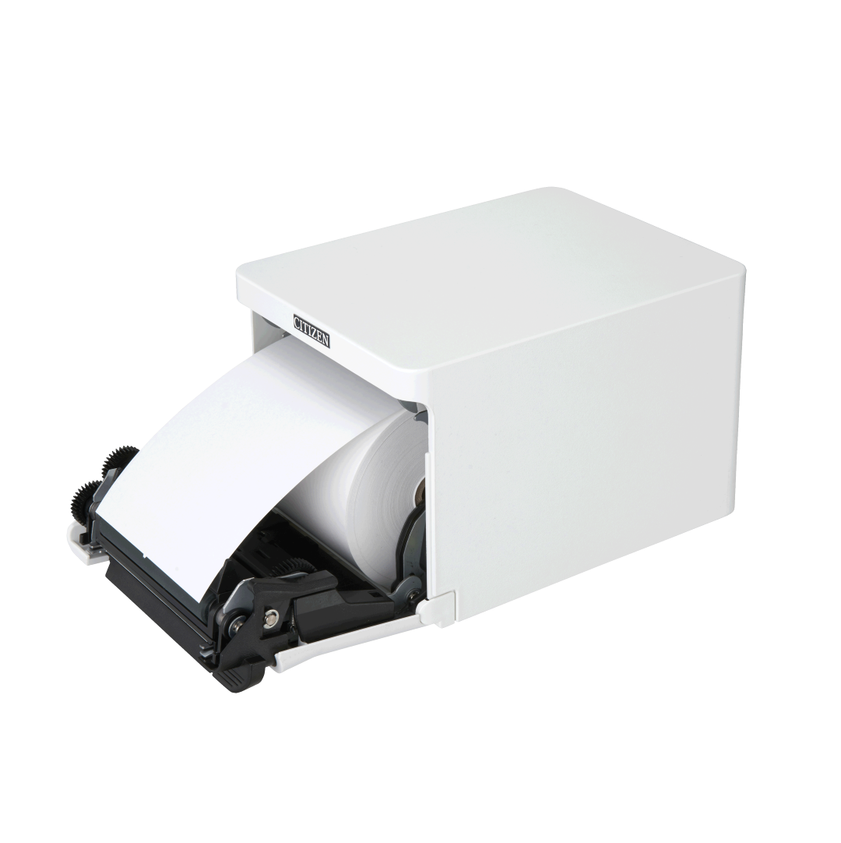
CL-S751
MEDIA
PAPER
Internal media rolls up 83mm diameter
Front loading via drop-down front cover
Paper width: 80mm +0.5 -1.0mm Paper width: 58mm +0.5 -1.0mm using included 2” media adapter
Media thickness 53 – 85 micron 0.0021 – 0.0033 inches

Slide 17
CT-S751
OPERATING
SYSTEMS
Linux CUPS
Windows 7, 10, Server 2008R2, 2012, 2016, 2019
iOS
macOS
Android
® Zebra, ZPL2, Eltron, EPL2 are registered trademarks of ZIH Corp. Datamax, Prodigy Plus are trademarks of Honeywell International Inc
Notes:
Add Logos

Slide 18
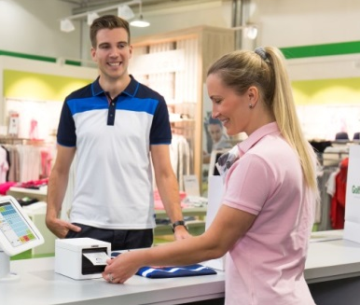
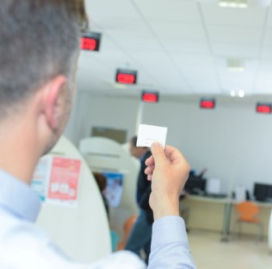
CT-S751 FRONT EXIT / LOADING 3” POS PRINTER
Specific Applications
HIGH SPEED RECEIPT PRINTING
Contemporary design for users who value modern aesthetics
COUPONS,VOUCHERS
& WIFI CODES
Print fast and on the spot discount and access codes
QUEUE
MANAGEMENT
Manage your queue in a structured & efficient manner
BETTING SLIP
Produce simple betting slips that are fit for purpose

Slide 19
CT-S751 FRONT EXIT / LOADING 3” POS PRINTER
Specific Applications
JOURNAL/DAILY REPORT
Complete important daily reports, like “end of day” slips
KITCHEN ORDERS
Take and fill kitchen orders quickly and accurately
WEIGHT SLIP
Record weights and prices of produce concisely and clearly.
RENTAL SLIP
Provide all vital rental information needed for great customer service

Slide 20
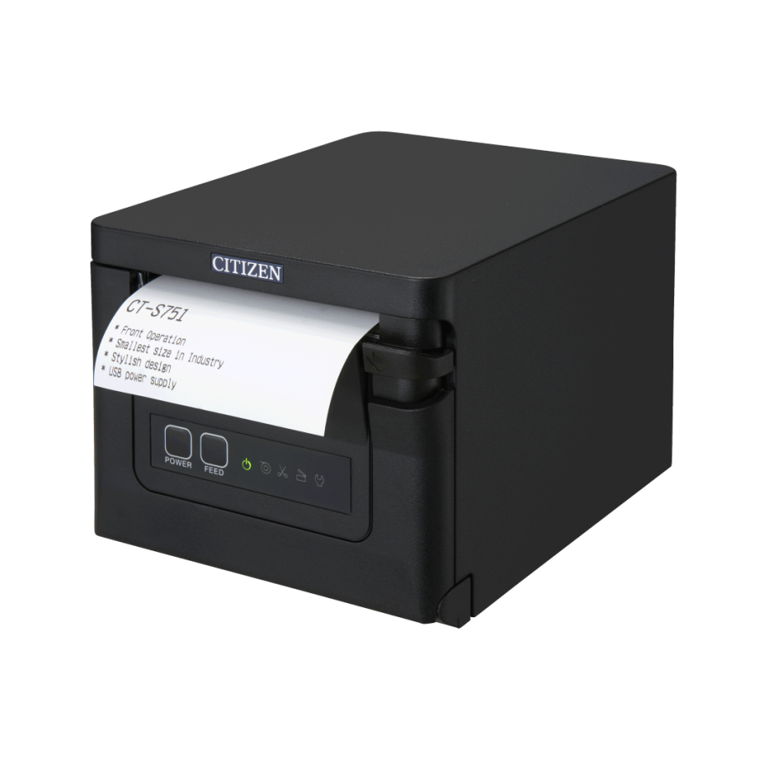
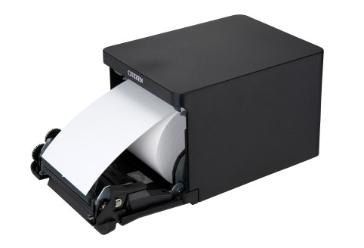
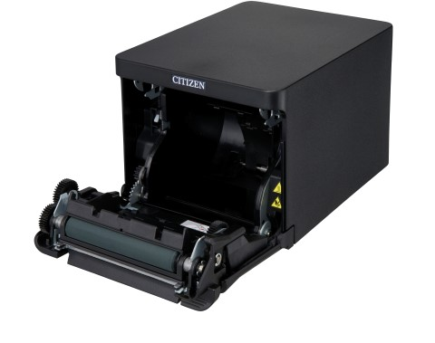
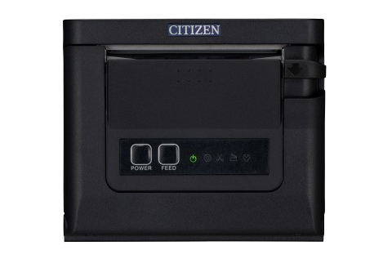
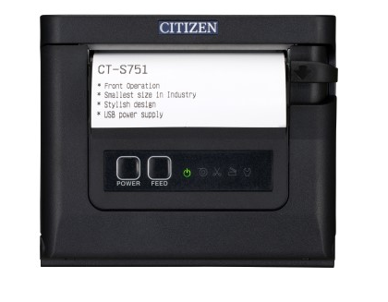
CT-S751
PRODUCT
IMAGES
203 dpi Direct Thermal
Front exit / loading POS printer

Slide 21
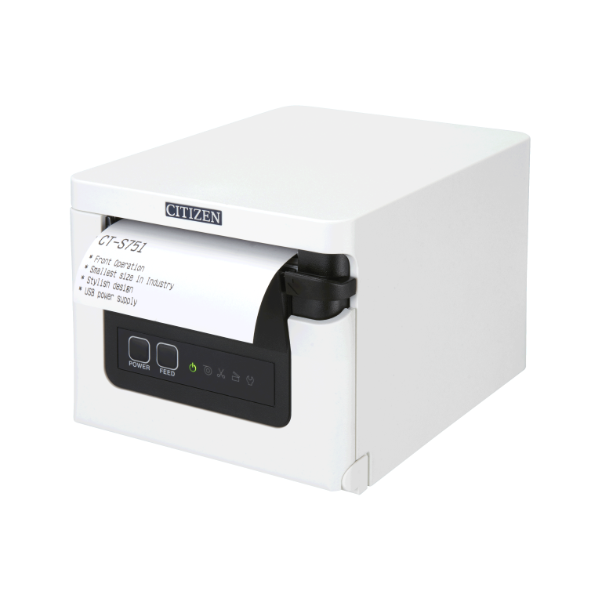
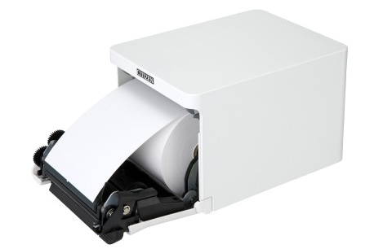
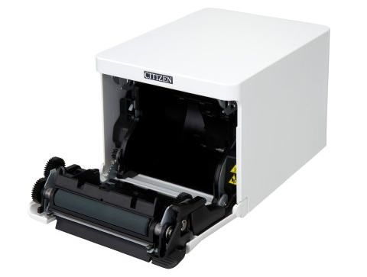
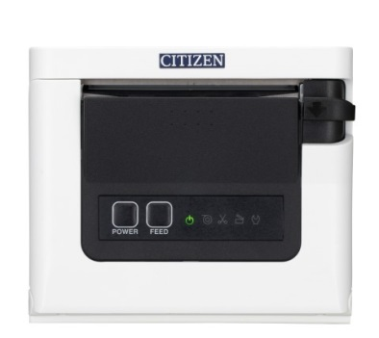
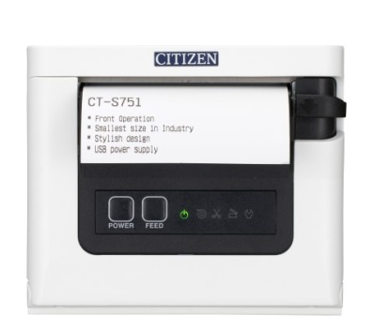
CT-S751
PRODUCT
IMAGES
203 dpi Direct Thermal
Front exit / loading POS printer

Slide 22
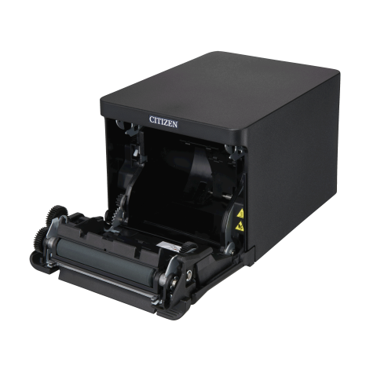
Model | CT-S751
Print speed | 350 mm/s max
Print width | 72 mm, 2.83 inches
Resolution | 203 dpi horizontal & vertical
Greyscale | 16 shades of grey at 100 mm/s
Media Sensor | PNE (Paper Near End) and Paper End
ROM | 8Mb of Flash Memory (firmware & user)
RAM | 8Mb of SDRAM (operation & user)
Fonts | A, B & C (12x24, 9x24 & 8x16 dots)
Character sets | 15 code pages, 17 character sets
Barcodes | 1D UPC-A , UPC-E , E NA-13(JAN 13)13), EAN 8(JAN-8) ITF, CODE39,CODE1 28 ,CODABAR (NW 7)7),CODE93,GS12D (PDF417, QR, Databar, Composites) 2D PDF 417 QR Code GS1 Databar, Composit Symbol
CT-S751
TECHNICAL
SPECIFICATIONS
Please refer to the Datasheet for full specs

Slide 23
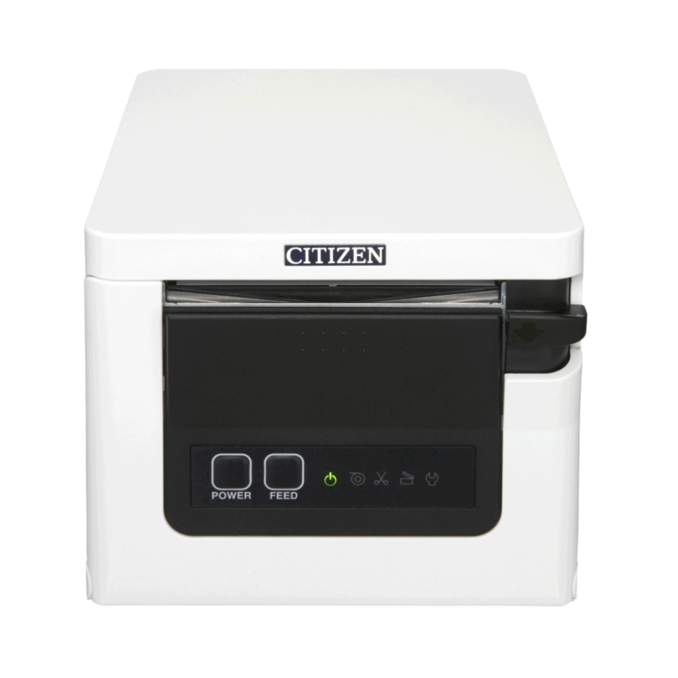
CT-S751
WHAT’S INSIDE
THE BOX
CT-S751 printer
AC Adapter
2” media partition
Quick start guide
Power Cord
Interface cover panel
Sample
media

Slide 24
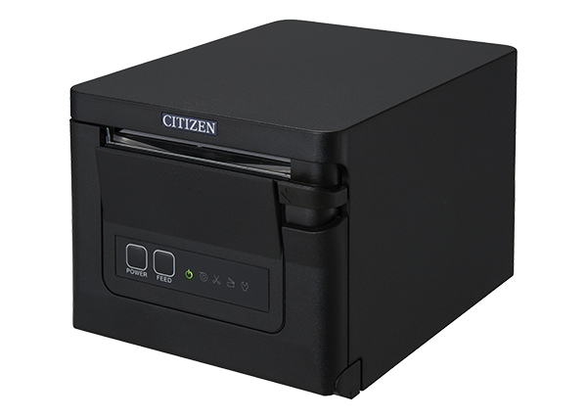
CT-S751
WARRANTY
OPTIONS
The following options are available for the
CT-S751 to extend the standard 2 year warranty
Full 3 years warranty cover
Full 5 years warranty cover
Notes:
Add warranty price?

Slide 25
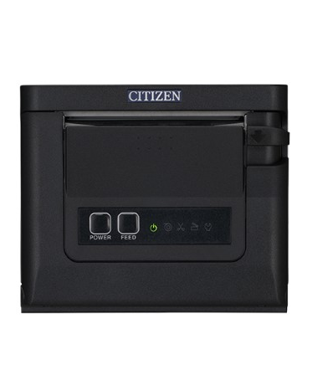
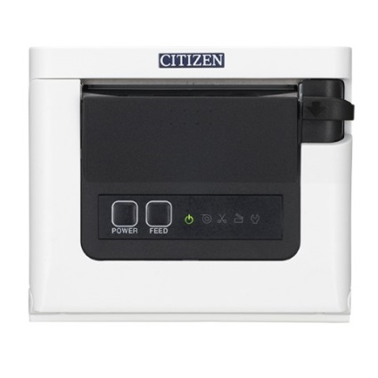
CT-S751
MARKETING
MATERIAL
OFFICIAL PRESS RELEASE
HIGH RES PRODUCT IMAGES
WEB GENERATED DATASHEET
PRODUCT PRESENTATION

Slide 26
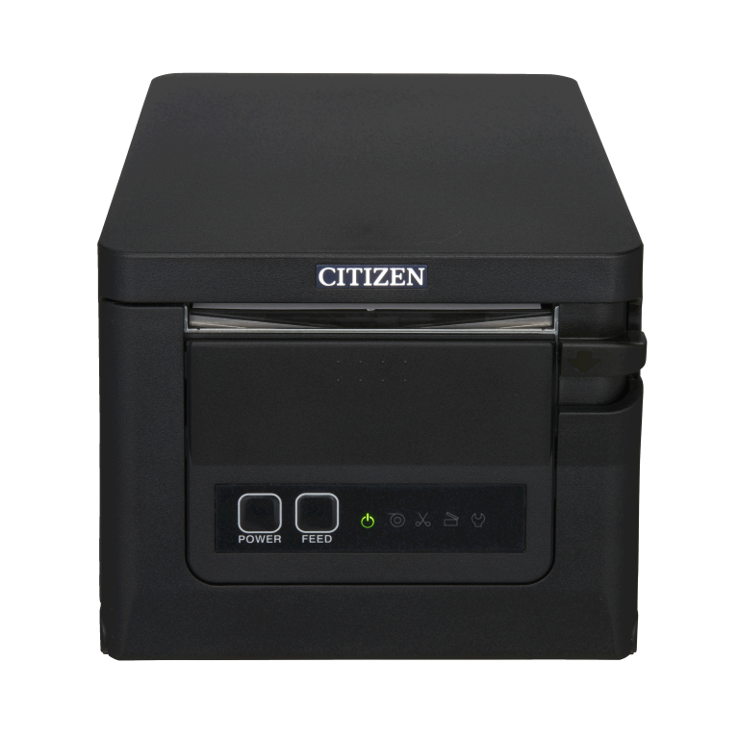
CT-S751
THANK YOU!
Please contact our sales experts to discuss your business needs
For marketing questions or product related inquiries please contact us at marketing@citizen-europe.com

Slide 27
ICONS ATTRIBUTION
From www.flaticon.com
icons made by Freepik
Network Interface Card
Cube
Roll
Durability
Fast/ speed
Business affiliate network
Attractive
Splash free
Water drop
Wifi icon
Android icon
Shield
Profit icon made by Kiranshastry
Network icon made by Good Ware
Solar energy icon made by prettycons
Send to front icon made by Google
Usb to front icon made by Google
Bluetooth icon made by Smashicons
Apple Big Logo made by Plainicon
Car free icon made by mynamepong

